Slide 1


Slide 2
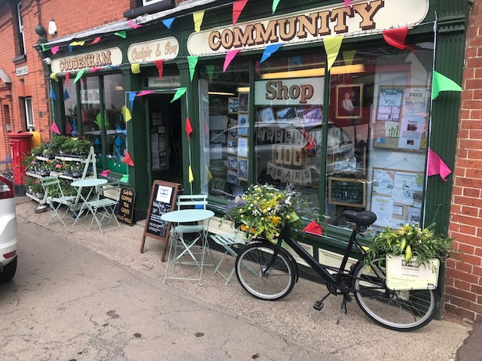
Six is a Three Letter Word……..
Continued Steady Financial Performance
  Sales Increased to £198,100 (up 7%)
  Gross Profit increased to £63,465 (up 16%)
  Gross margin increased to 32% (from 29%)
  Gross profit from Coffee Stop £24,186 up from £20,038
  Provides 38% gross profits from 19% sales
  Pre-tax profit £3165 (£2504 after tax)
Volunteer resilience again maintained the continuity of the business in a still challenging environment.

Slide 3
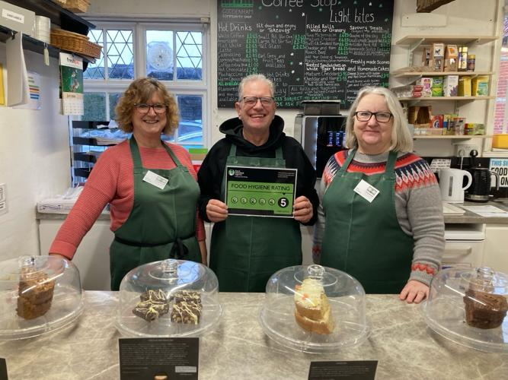
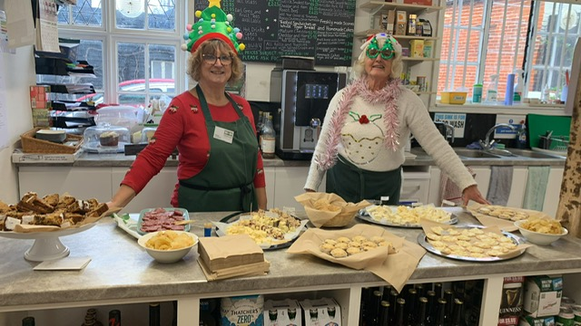
Some Key Headlines
  New 5-year lease signed
  5* Food Hygeine Rating - Again
  New offerings in the coffee stop e.g. Toasted Teacakes
  New products introduced e.g “Freshly Frozen Fish”
  New Craft Products e.g Woodworkers
  Support from Day Foundation –improved staffing coverage for Hannah and Diana
  Reduced Pressure on Committee
  Un - erring dedication of volunteers – many of them new – and young and older!
  Great customer feedback – now 4.9 on Google!

Slide 4
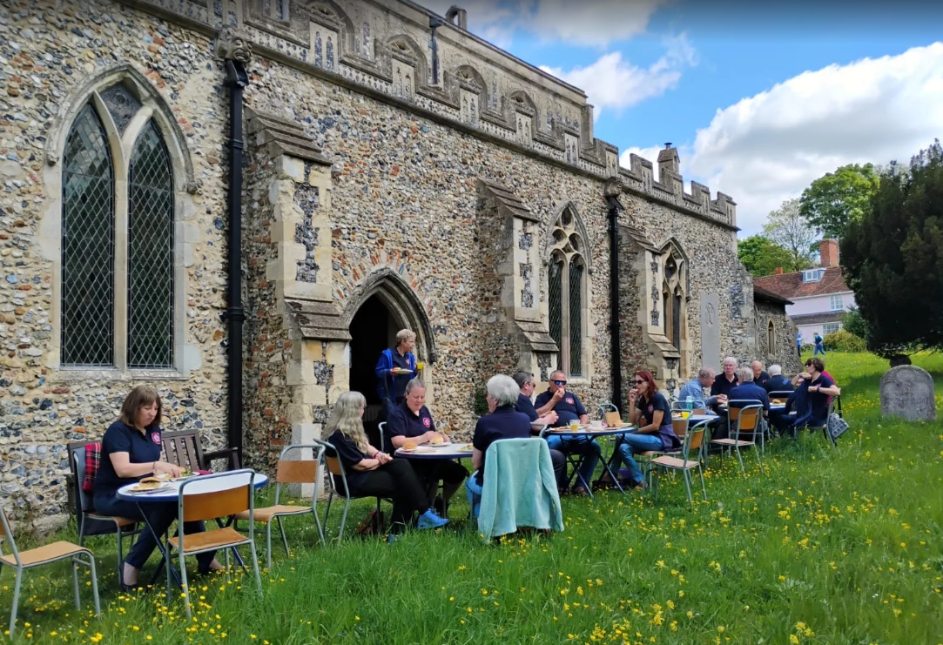
What 4.9 Score on Google Looks Like
“What fantastic service!!! 23 Bellringers needed lunch before ringing at SMTV Church… last Saturday (3rd May). Contacted the Community Shop who said ‘Don’t think we can fit that many in our shop but we can do a Pop-Up cafe in the Churchyard if you like?’ It was wonderful!!! “
“I have been coming to this shop off and on for 40 years….. it retains the charm and community feel a local rural English shop should have. Very friendly staff with excellent local produce including a small cafe with locally baked cakes and also crafts. Highly recommended both for the passerby and the more local customers. I look forward to my next visit!”
“Fantastic community shop. Amazing selection of local produce and crafts, excellent café and superb Volunteer staff”
“Love it here!”

Slide 5
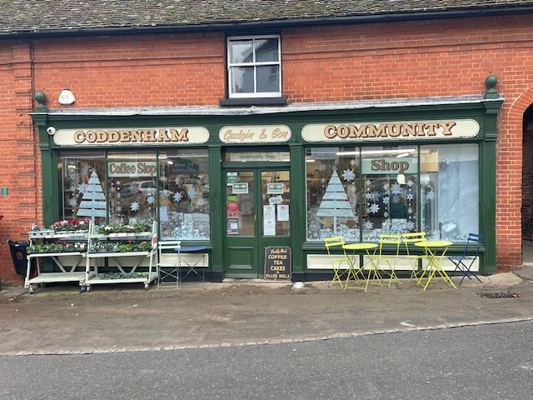
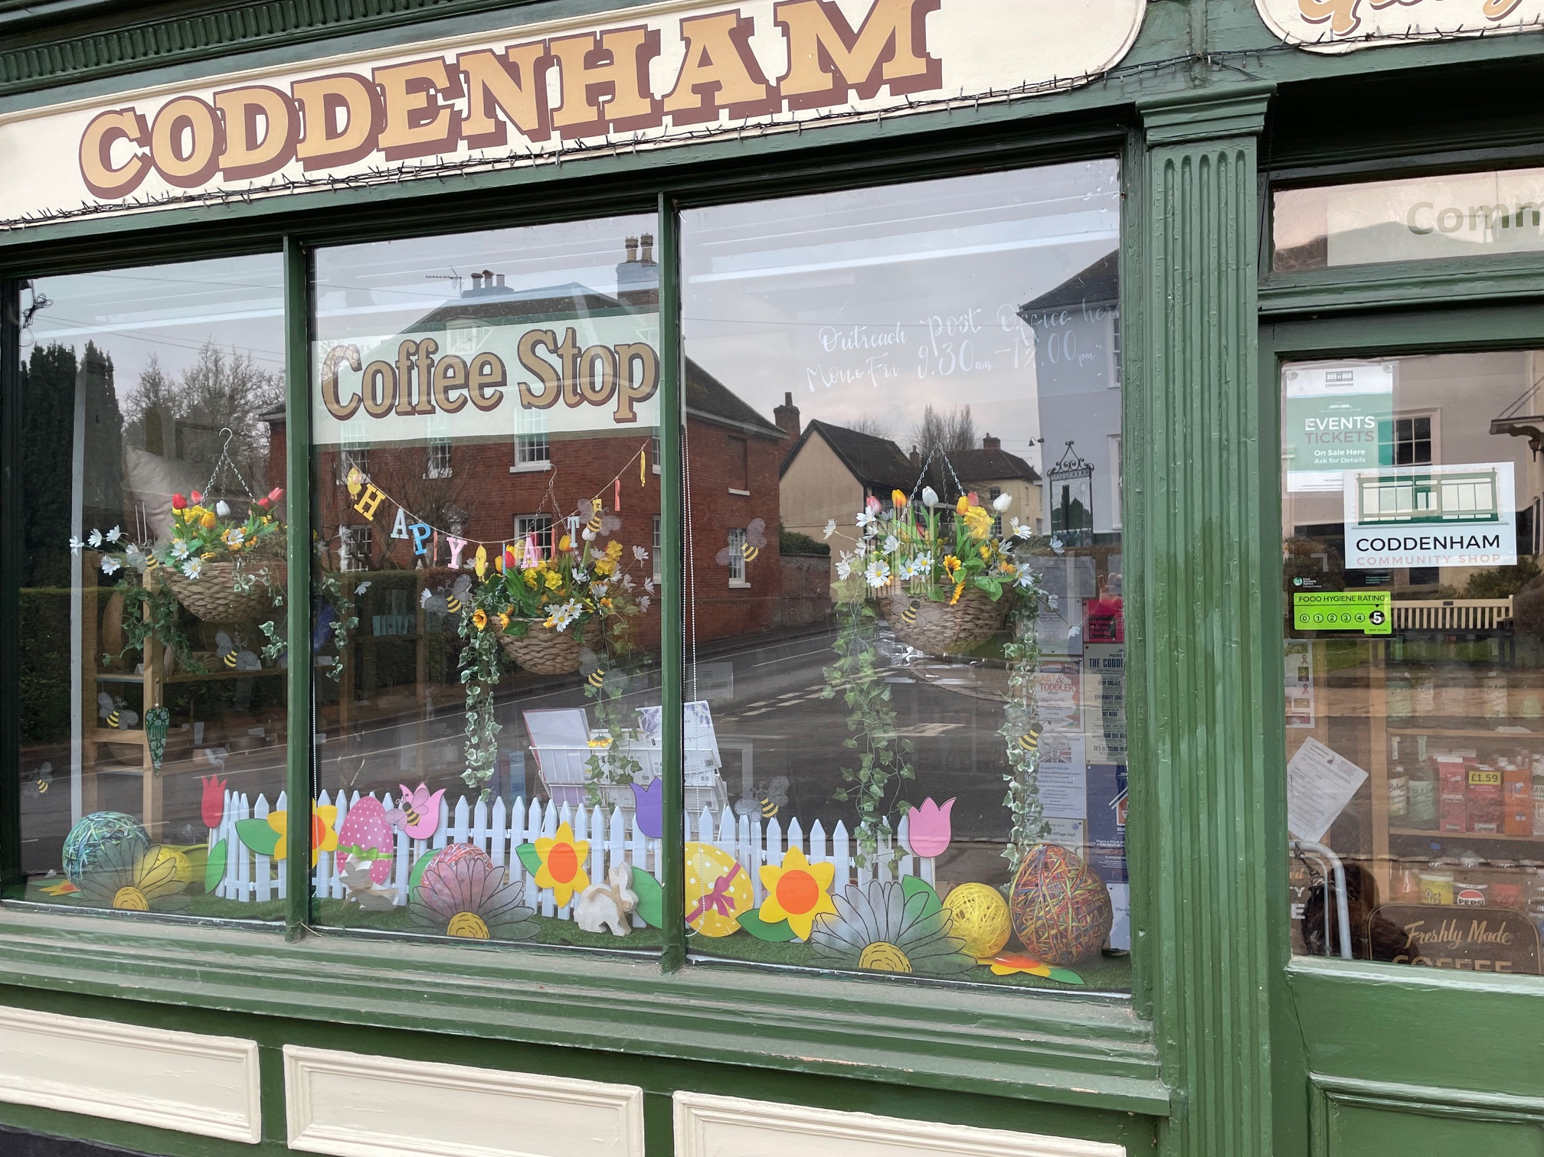
Securing Our Future
Business Year to Date
  We made a slight profit, reversing last years loss
  Increased cash and net assets
  Sales growth on steady trajectory
  After 6 years we are actually getting good at what we do!
Key Focus
  Ramp up demand
  Invest in updating facilities (Fridges, Coffee Machine, Toilets)
  Succession Planning / Committee Re-fresh
  Business premises options for the future

Slide 6
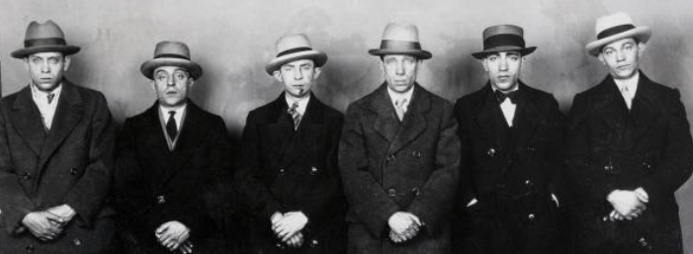
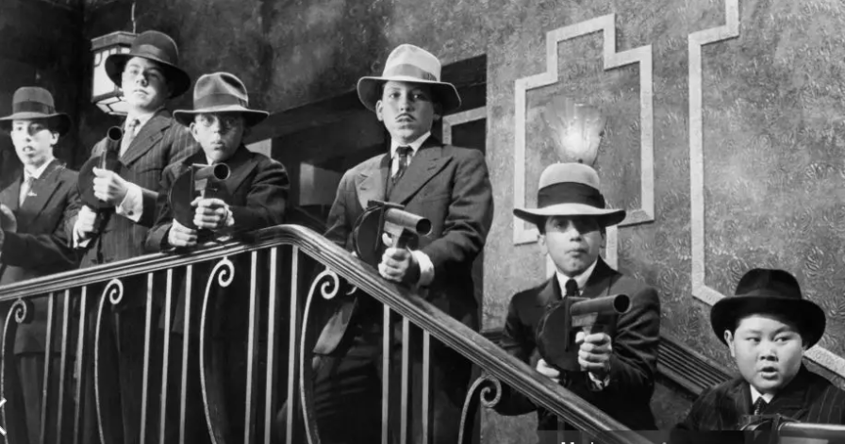
Key Focus 2026/27
  Sales and Business Re-fresh
  Ramp up demand and business pipeline
  Invest in updating facilities (Fridges, Coffee Machine, Toilets)
  Succession Planning / Committee Re-fresh

Slide 7
Thank You
Time For A NIBBLE

